Slide 1
Ohm’s Law, Energy, and Power
DC/AC Fundamentals: A Systems Approach
Thomas L. Floyd
David M. Buchla
Chapter 3

Slide 2
Ch.3 Summary
Review of V, I, and R
Voltage is the amount of energy per charge available to move electrons from one point to another in a circuit, measured in volts.
Current is the rate of charge flow, measured in amperes.
Resistance is the opposition to current, measured in ohms.

Slide 3
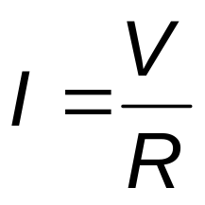
Ch.3 Summary
Ohm’s Law
The most important fundamental law in electronics is Ohm’s law, which relates voltage, current, and resistance.
Georg Simon Ohm (1787-1854) formulated the equation that bears his name:
What is the current in a circuit with a 12 V source if the resistance is 10 Ω ?
1.2 A

Slide 4

Ch.3 Summary
Ohm’s Law
If you need to solve for voltage, Ohm’s law is:
What is the voltage across a 680 Ω resistor if the current is 26.5 mA?
18 V

Slide 5
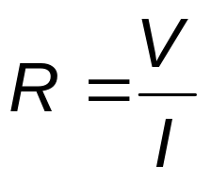
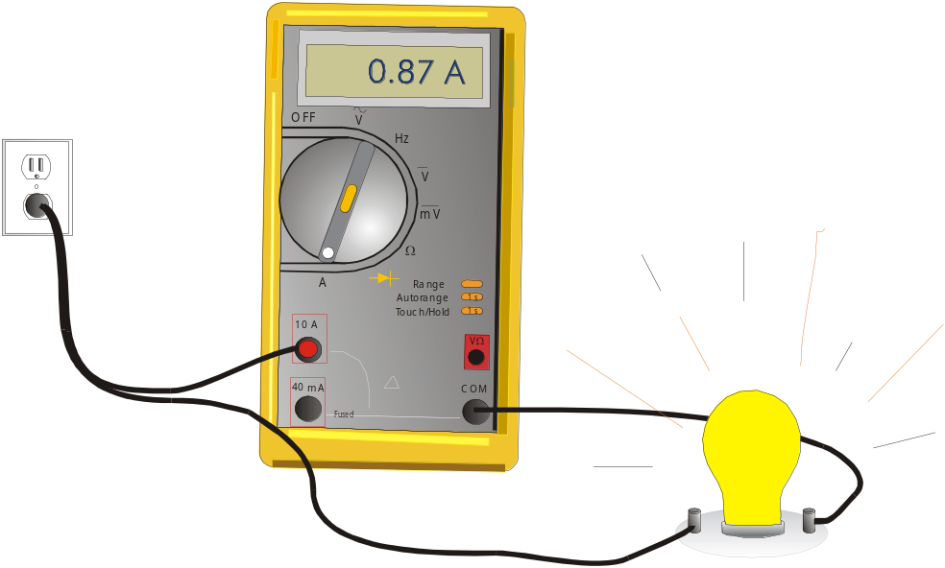
Ch.3 Summary
Ohm’s Law
If you need to solve for resistance, Ohm’s law is:
What is the (hot) resistance of the bulb?
115 V
132 Ω

Slide 6
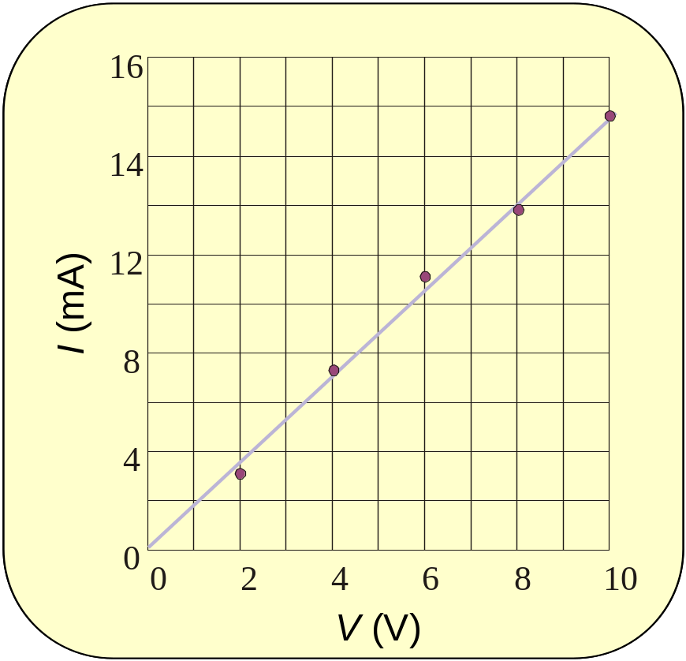
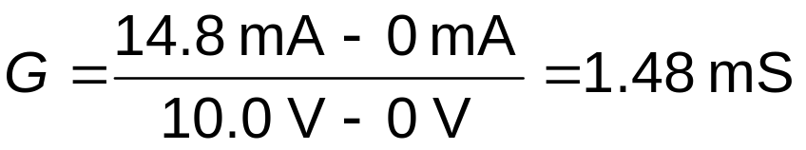
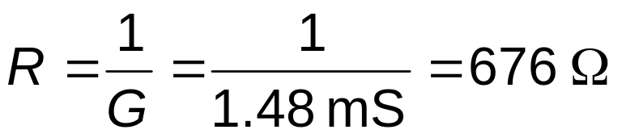
Ch.3 Summary
A student takes data for a resistor and plots the data as shown. What is the conductance and the resistance of the resistor?
The slope represents the conductance.
The reciprocal of the conductance is the resistance.

Slide 7
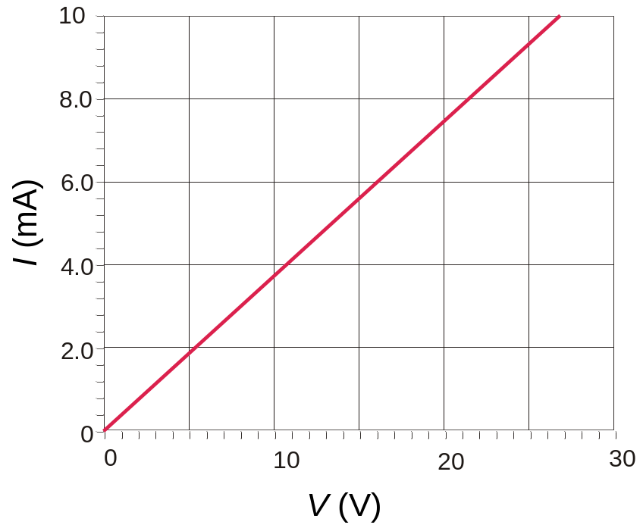
Ch.3 Summary
Graph of Current Versus Voltage
The plot of current versus voltage for a fixed resistor is a line with a positive slope.
What is the resistance indicated by the graph?
2.7 kΩ
What is its conductance?
0.37 mS

Slide 8
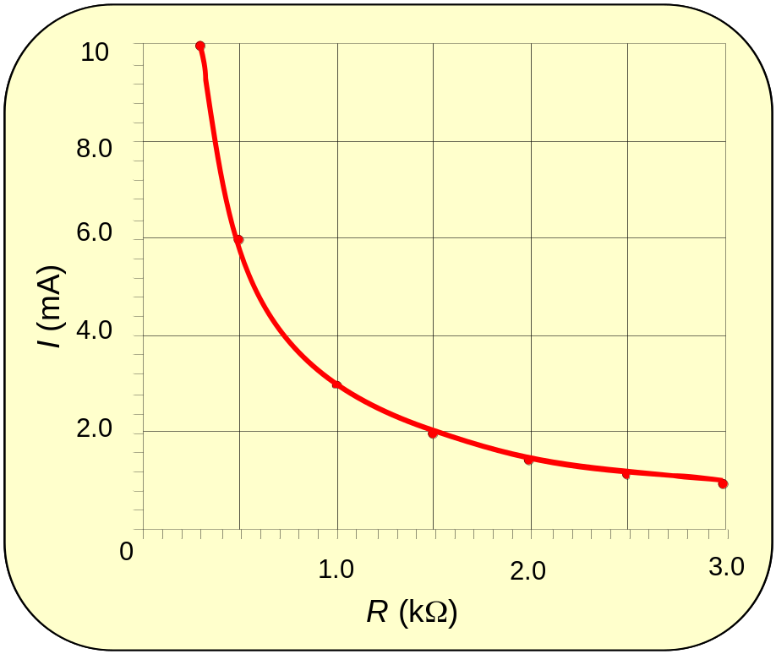
Ch.3 Summary
Graph of Current Versus Resistance
If resistance is varied for a constant voltage, the current versus resistance curve plots a hyperbola.
What is the curve for a 3-V source?

Slide 9
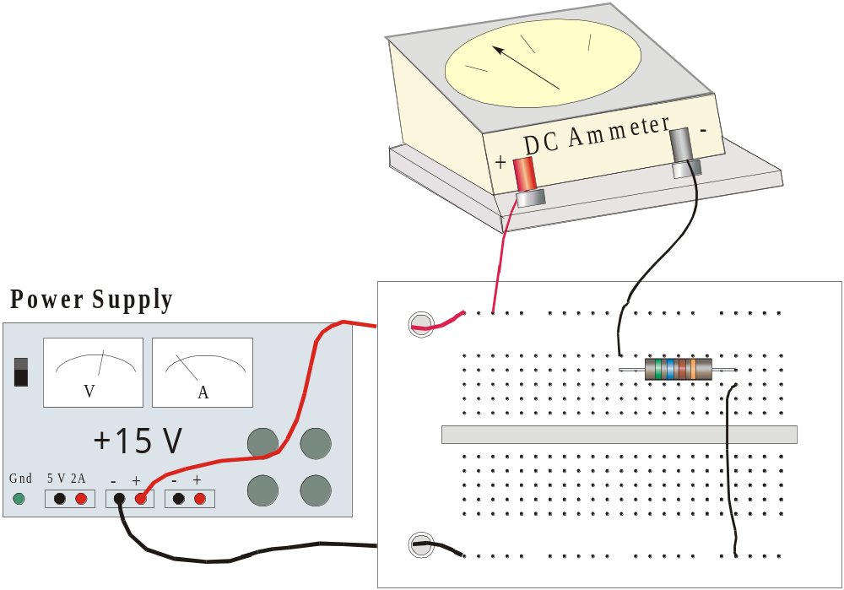
Ch.3 Summary
Application of Ohm’s Law
The resistor color code is green-blue-brown-gold.
What should the ammeter read?
26.8 mA

Slide 10
Ch.3 Summary
Energy and Power
When a constant force is applied to move an object over a distance, the work is the force times the distance. The force must be measured in the same direction as the distance.
The unit for work is the newton-meter (N-m) or joule (J).
Distance
Force

Slide 11
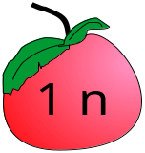
Ch.3 Summary
Energy and Power
One joule is the work done when a force of one newton is applied through a distance of one meter. A joule is a small amount of work approximately equal to the work done in raising an apple over a distance of 1 m.
1 m
The symbol for energy, W, represents work, but should not be confused with the unit for power, the watt, W.

Slide 12
Ch.3 Summary
Energy and Power
Energy is closely related to work. Energy is the ability to do work. As such, it is measured in the same units as work, namely the Newton-meter (N-m) or joule (J).
What amount of energy is converted to heat in sliding a box along a floor for 5 meters if the force to move it is 400 n?
2000 J
W = Fd = (400 N)(5 m) = 2000 N-m =

Slide 13
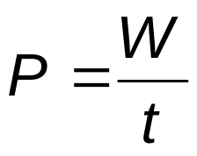
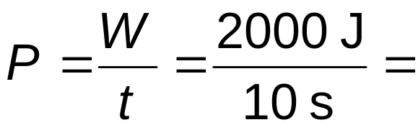
Ch.3 Summary
Energy and Power
Power is the rate of doing work. Because it is a rate, a time unit is required. The unit is the joule per second (J/s), which defines a watt (W).
What power is developed if the box in the previous example is moved in 10 s?
200 W

Slide 14
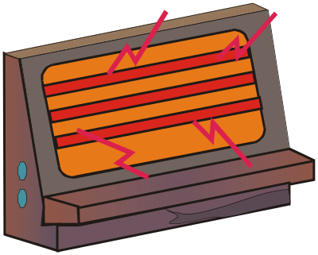
Ch.3 Summary
Energy and Power
The kilowatt-hour (kWh) is a much larger unit of energy than the joule. There are 3.6 x 10⁶ J in a kWh. The kWh is convenient for electrical appliances.
What is the energy used in operating a 1200 W heater for 20 minutes?
1200 W = 1.2 kW
20 min = 1/3 h
1.2 kW × 1/3 h =
0.4kWh

Slide 15
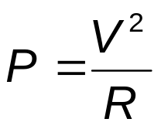


Ch.3 Summary
Energy and Power
In electrical work, the rate energy is dissipated can be determined from any of three forms of the power formula.
Together, the three forms are called Watt’s law.

Slide 16
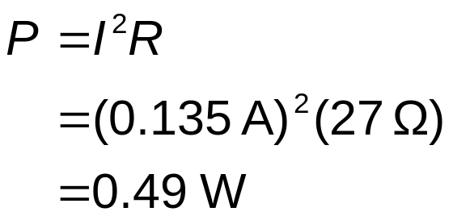
Ch.3 Summary
Energy and Power
What power is dissipated by a 27-Ω resistor if the current is 0.135 A?
Given that you know the resistance and current, substitute the values into P =I ²R.

Slide 17
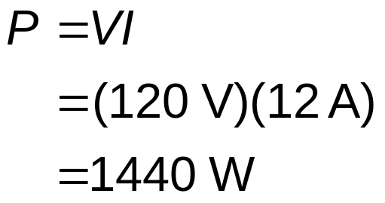
Ch.3 Summary
Energy and Power
What power is dissipated by a heater that draws 12 A of current from a 120 V supply?
The most direct solution is to substitute into P = IV, as follows:

Slide 18
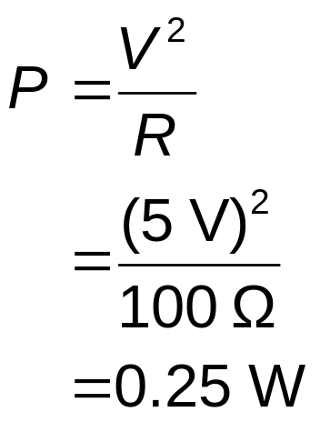
Ch.3 Summary
Energy and Power
What power is dissipated by a 100-Ω resistor with 5 V across it?
The most direct solution is to substitute into P= V² / R, as follows:
It is important to remember that small resistors operating in low voltage systems need to be sized for the anticipated power.

Slide 19
Ch.3 Summary
Resistor Failures
Resistor failures are unusual except when they have been subjected to excessive heat. Look for discoloration (sometimes the color bands appear burned). Test with an ohmmeter by disconnecting one end from the circuit to isolate it and verify the resistance. Correct the cause of the heating problem (larger wattage resistor?, wrong value?).
Normal Overheated

Slide 20
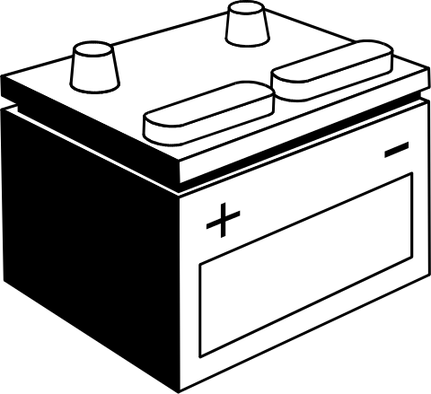
Ch.3 Summary
Ampere-hour Rating of Batteries
Expected battery life of batteries is given as the ampere-hours specification. Various factors affect this, so it is an approximation. (Factors include rate of current withdrawal, age of battery, temperature, etc.)
How many hours can you expect to have a battery deliver 0.5 A if it is rated at 10 Ah?
20 h

Slide 21
Ch.3 Summary
Troubleshooting
Some questions to ask before starting any troubleshooting are:
Has the circuit ever worked?
If the circuit once worked, under what conditions did it fail?
What are the symptoms of the failure?
What are the possible causes of the failure?

Slide 22
Ch.3 Summary
Troubleshooting
Plan the troubleshooting by reviewing pertinent information:
Schematics
Instruction manuals
Review when and how the failure occurred.

Slide 23
Ch.3 Summary
Troubleshooting
You may decide to start at the middle of a circuit and work in toward the failure. This approach is called half-splitting.
Based on the plan of attack, look over the circuit carefully and make measurements as needed to localize the problem. Modify the plan if necessary as you proceed.
After solving the problem, it is useful to ask, “How can I prevent this failure in the future?”

Slide 24
Ch.3 Summary
Selected Key Terms
Ohm’s law
Linear
Energy
Power
Joule
A law stating that current is directly proportional to voltage and inversely proportional to current.
Characterized by a straight-line relationship.
The ability to do work. The unit is the joule (J).
The rate of energy usage.
The SI unit of energy.

Slide 25
Ch.3 Summary
Selected Key Terms
Watt
Kilowatt-hour
Ampere-hour rating
Efficiency
The unit of power. One watt is the power when 1 J of energy is used in 1 s.
A common unit of energy used mainly by utility companies.
A number determined by multiplying the current (A) times the length of time (h) that a battery can deliver that current to a load.
The ratio of output power to input power of a circuit, usually expressed as a percent.

Slide 26
Ch.3 Summary
Quiz
1. Holding the voltage constant, and plotting the current against the resistance as resistance is varied will form a
a. straight line with a positive slope
b. straight line with a negative slope
c. parabola
d. hyperbola

Slide 27
Ch.3 Summary
Quiz
2. When the current is plotted against the voltage for a fixed resistor, the plot is a
a. straight line with a positive slope
b. straight line with a negative slope
c. parabola
d. hyperbola

Slide 28
Ch.3 Summary
Quiz
3. For constant voltage in a circuit, doubling the resistance means
a. doubling the current
b. halving the current
c. there is no change in the current
d. depends on the amount of voltage

Slide 29
Ch.3 Summary
Quiz
4. A resistor is color-coded red-violet-orange-gold. If it is placed across a 12 V source, the expected current is
a. 0.12 mA
b. 0.44 mA
c. 1.25 mA
d. 4.44 mA

Slide 30
Ch.3 Summary
Quiz
5. If the current in a 330 Ω resistor is 15 mA, the voltage across it is approximately
a. 5.0 V
b. 22 V
c. 46 V
d. 60 V

Slide 31
Ch.3 Summary
Quiz
6. A unit of power is the
a. joule
b. kilowatt-hour
c. both of the above
d. none of the above

Slide 32
Ch.3 Summary
Quiz
7. The SI unit of energy is the
a. volt
b. watt
c. joule
d. kilowatt-hour

Slide 33
Ch.3 Summary
Quiz
8. If the voltage in a resistive circuit is doubled, the power will be
a. halved
b. unchanged
c. doubled
d. quadrupled

Slide 34
Ch.3 Summary
Quiz
9. The approximate power dissipated by a 330 Ω resistor with 9 V across it is
a. ¼ W
b. ½ W
c. 1 W
d. 2 W

Slide 35
Ch.3 Summary
Quiz
10. Before troubleshooting a faulty circuit you should find out
a. If the circuit ever worked
b. The conditions that existed when it failed
c. The symptoms of the failure
d. All of the above

Slide 36
Ch.3 Summary
Quiz Answers
1. d
2. a
3. b
4. b
5. a
6. d
7. c
8. d
9. a
10. d

